Slide 1

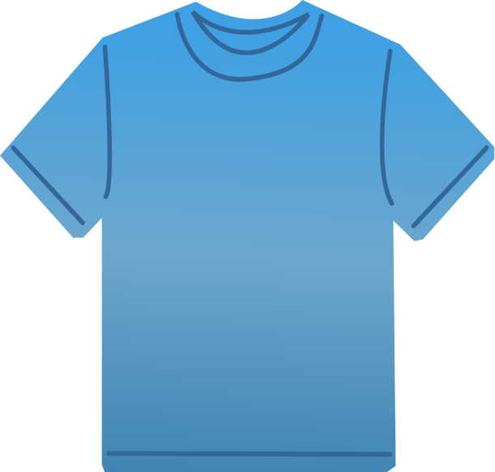
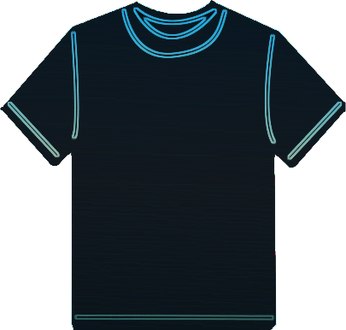
K NEAREST NEIGHBORS (KNN): INTUITION
k-nearest neighbors algorithm (KNN) is a classification algorithm.
KNN works by finding the most similar data points in the training data, and attempt to make an educated guess based on their classifications.
SIZE: SMALL
SIZE: LARGE
HEIGHT (CMS)
L
150 160 170 180
S
?
55 60 65 70
WEIGHT (KGS)

Slide 2
K NEAREST NEIGHBORS (KNN): ALGORITHM STEPS
Select a value for k (e.g.: 1, 2, 3, 10..)
Calculate the Euclidian distance between the point to be classified and every other point in the training data-set
Pick the k closest data points (points with the k smallest distances)
Run a majority vote among selected data points, the dominating classification is the winner! Point is classified based on the dominant class.
Repeat!

Slide 3
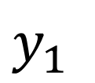

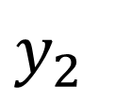

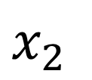
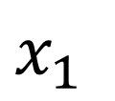
EUCLIDEAN DISTANCE: INTUITION
$$Euclidean Distance= \sqrt{{\left(x_{2}−x_{1}\right)}^{2}+{\left(y_{2}−y_{1}\right)}^{2}}$$
$y_{2}$
$Point B {(x}_{2}, y_{2})$
$y_{1}$
$Point A {(x}_{1}, y_{1})$
$x_{1}$
$x_{2}$

Slide 4
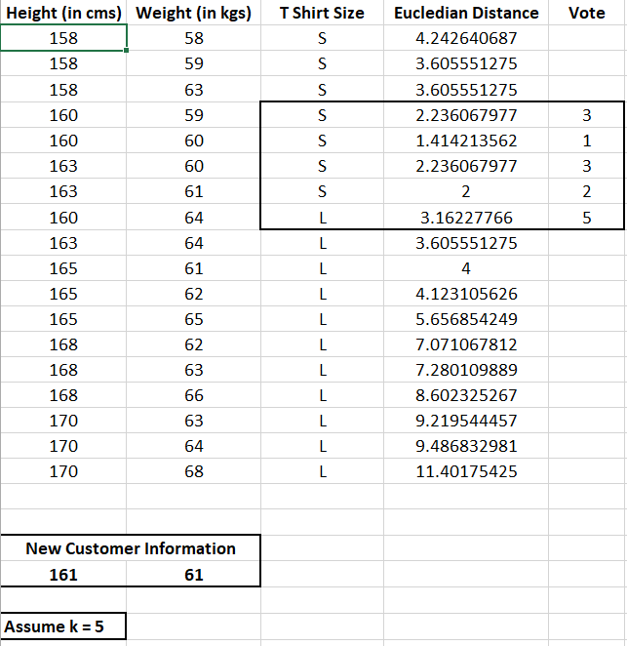
K NEAREST NEIGHBORS (KNN): EXAMPLE
KNN will look for the 5 data points that are closest to the new customer data point
The algorithm will determine which category (class) are these 5 points in.
Since 4 points had class ‘Small’ and 1 had ‘Large’, then new customer shall be assigned Small size.
L
S
https://www.listendata.com/2017/12/k-nearest-neighbor-step-by-step-tutorial.html

Slide 5
K NEAREST NEIGHBORS (KNN): EXAMPLE
Let’s understand this example visually!
SIZE: SMALL
HEIGHT (CMS)
SIZE: LARGE
L
150 160 170 180
S
POINT CLASSIFIED AS BLUE (S SIZE)
?
55 60 65 70
WEIGHT (KGS)

